Slide 1
SD: Patterns ASP.NET
02 Jan 18 | Start
27 Jun 18 | 1: 4- 6
27 Jun 18 | 3: 77- 80
Appendix
Online

Slide 2
ASP.NET Patterns
Ch | Date
1 | 00 May 18
2
3
4
5
6
7
8
Beginning SOLID Principles and Design Patterns for ASP.NET Developers 2016

Slide 3
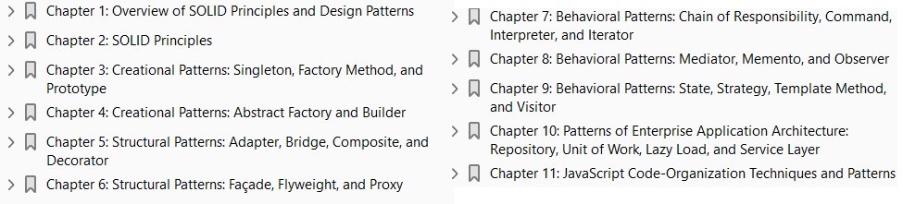

Slide 4
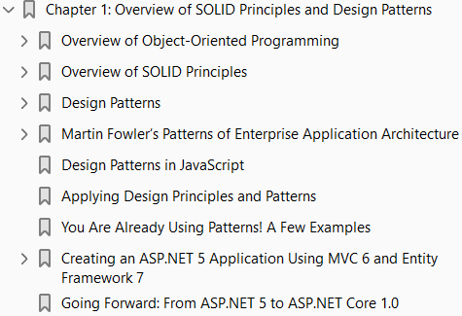
1
Overview of SOLID Principles and Design Patterns

Slide 5
Intro
Modern programming languages such as C# are object oriented in nature.
The C# language allows you to think and program in terms of classes and objects.
However, knowing C# language keywords and features is just one part of the story.
Equally important is knowing how these features can be put to use in the best possible way so as to result in a better quality code base and ultimately help in building software that is
Robust
Flexible
maintainable, and
Extensible
In order to build a better quality code base, developers resort to collective wisdom.
This collective wisdom has withstood the test of time and offers proven approaches to solving a software problem instead of your attempting to invent a new solution.

Slide 6
Agenda
This chapter will introduce you to this collective wisdom.
Specifically, it will cover the following:
fundamental concepts of object-oriented programming
what SOLID principles are and how they help design better object-oriented systems
Gang of Four (GoF) design patterns and their categorization
what Patterns of Enterprise Application Architecture (P of EAA) are and their categorization
how patterns can also be useful in the JavaScript world
This chapter will only touch on the basics of the above topics.
The rest of the book will elaborate them in detail.
In this chapter I intend to give you a clear picture of the scope of this book so that you have an idea of what’s coming up in further chapters.

Slide 7
Overview of Object-oriented Programming
C# is an object-oriented programming language.
As an ASP.NET developer who knows C#, you are probably aware of its features and capabilities
Since this book is about object-oriented design principles and patterns, let’s quickly brush up on our knowledge of the fundamental building blocks of object-oriented programming.
This section will discuss features of object-oriented programming such as
Classes objects
Abstraction encapsulation
Inheritance interfaces
Polymorphism
If you are already familiar with these concepts, feel free to skip or skim through this section.
If you are unsure about your understanding of these concepts, I suggest that you read this section and make sure that you are comfortable with the material.
These features are heavily used in any object-oriented system, and the rest of this book will assume that you understand them. Let’s begin!

Slide 8
Classes and Objects
Classes and objects are used everywhere in C# and .NET framework.
When you create a console application, its Main( ) method is housed in a class.
When you create an ASP.NET Web Forms application, each web form is nothing but a class.
When you create an ASP.NET MVC application, a controller is also a class.
What is a class?
Simply put, a class is a blueprint or template for creating a type.
A class typically groups data and behavior of a type.
For example, fruits, flowers, vehicles, animals, and birds all are classes.
Some real-world examples of classes are customers, orders, employees, and so on.
An object is a particular instance of class.
For example, orange is an instance of fruit.
Or an employee with ID 1234 is an instance of the Employee class.
In C# you create classes and objects as shown in Code 1-1.
You use the class keyword to define a class.

Slide 9
Classes and Objects |
Although not shown in the previous example, a class usually contains
Properties
methods, and
Events
Once created, a class can be instantiated using the new keyword.
So, in the earlier code snippet, Employee is a class and obj is an instance of the Employee class.

Slide 10
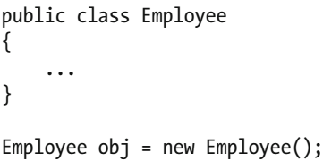
Code 1-1

Slide 11
Abstraction
You just learned what classes and objects are. But who identifies classes, and how? Of course, as a developer you are responsible for identifying and crafting classes. When you read some business requirement that you are supposed to cater to with your application, you need to study the scenario and identify the software requirements. A scenario may involve many pieces of information as well as many ways, from simple to complex, in which that information is used by the underlying business. Based on your understanding of the scenario, you need to decide which pieces of information are essential for your application and which pieces are unnecessary. The pieces that are essential will then be put into one or more classes. This process of filtering the available information and arriving at a subset that is essential for your application is called abstraction . Suppose you are building a business-contact management application. As a part of the development you identified that you will need a Person class in your application. Now, there can be plethora of details available about a person—first name, last name, e-mail, phone number, company name, address, photo, birth date, number and details of his immediate family members as well as relatives, year in which he or she completed secondary school, his or her favorite color, and many more. Given that your application is supposed to deal with business contacts, do you need to capture all the details just mentioned? Obviously not. Your application will need details such as first name, last name, e-mail, phone number, company name, address, photo, and birth date. But other personal details such as number and details of his immediate family members as well as relatives, year in which he or she completed secondary school, and his or her favorite color are irrelevant to your application. Thus, while creating the Person class, you will skip these unwanted pieces of information. The process of abstraction is shown in Figure 1-1 .
(Page 2).

Slide 12
Encapsulation
The process of abstraction helps you clarify which pieces of information are needed by your application. You usually bundle these pieces into one or more classes. Continuing the example we discussed in the preceding section, you will put the essential information about a business contact into a class named Contact . Although you have identified and bundled the required pieces into a class, should other parts of the application be allowed to see and manipulate them directly? Or should there be some prescribed way in which the data can be dealt with? These thoughts comprise a process called encapsulation . Suppose you created a Contact class that bundles the first name, last name, e-mail, phone number, address, company name, photo, and birth date of a person. If you simply bundle these details together without any prescribed way of reading and writing them, the other parts of the application that use the Contact class are free to access them in any way they want. For example, some part of the application may assign a value of 1234 to the email address. Obviously, this is unacceptable. So, you should devise some mechanism such that only a valid e-mail address can be assigned to a contact. Similarly, you may want to reveal the photo of a contact only to some special users of your application (for example, administrators or paid users). Again, you need some prescribed way to handle this type of access. That’s where encapsulation comes into the picture. Encapsulation is a process by which you both bundle data and operations (or functions) that work on that data into a class and also establish a prescribed way to read, write, and process the data. In terms of C#, you encapsulate data using classes, properties, and methods. Listing 1-1 shows what your Contact class that encapsulates the required data might look like.

Slide 13
Inheritance
A real-world application involves many classes. At times these classes share something in common. For example, imagine that our contact manager application needs to take into account different types of contacts, such as business contacts (companies you interact with), professional contacts (individuals such as doctors and tax consultants that provide professional services), personal contacts (school friends, neighbors, people from your social network, and so on. Obviously you need a class to represent each type of contact, say BusinessContact , ProfessionalContact , and PersonalContact . As you might have anticipated, these classes share many common attributes. For example, all of them will have first name, last name, address, e-mail, and phone number. Can you do something to avoid this duplication? That’s where inheritance comes into the picture. Inheritance allows you to isolate common pieces of data and operations into a class and then create specialized classes based on that class. The class containing common data and operations is called the base class , whereas the specialized classes are called derived classes . The derived class and the base class are related to each other through an “is-a” relationship. This means a derived class (say, BusinessContact ) is a kind of base class (say, Contact ). The derived classes can add data and operations that are specific to themselves. They can also redefine the operations defined by the base class. To carry the same example further, you would create a Contact base class and BusinessContact , ProfessionalContact , and PersonalContact derived classes that inherit from the Contact class. Inheritance not only promotes code reuse but also helps you organize code into hierarchical structures. Listing 1-2 shows what these classes look like.
(Page 6).

Slide 14
Abstract Classes and Interfaces
In the preceding section you used inheritance as a means to reusing code. There are times when classes can have a parent-child relationship, but there can’t be any possibility of code reuse. Consider that you are building a taxation system that is supposed to calculate taxes based on certain logic. In addition, let’s suppose that your application needs to support tax calculation in three countries—say the USA, the UK, and India. Now the taxation rules and logic in a country are usually quite specific to that country, and you may not be able to reuse any of this code. However, the operation—calculating tax—is needed in all of them. In such cases, although you can’t reuse any code, you can reuse “contract.” In such cases, developers resort to abstract classes or interfaces. An abstract class is a class that cannot be instantiated. It usually contains property and method signatures but no implementation. The derived classes are required to write the implementation of these members by overriding them. So, with an abstract class in place, the preceding example can be represented as shown in Listing 1-3
(Page 7).

Slide 15
Polymorphism
Polymorphism means multiple forms of something. Let’s say you own a washing machine and a vacuum cleaner. Both are machines and can be started and stopped using their respective switches. However, your order to start and stop a machine is obeyed quite differently by the respective machines. And it also results in different results. A washing machine, when started, is going to wash clothes, whereas a vacuum cleaner is going to clean the floor when started. Thus, the same order—“start”—has two different results based on the machine to which it has been issued. The same can be said about the “stop” instructions. How does this apply to classes? Imagine the preceding real-world example in terms of classes. The WashingMachine and VacuumCleaner classes bear an “is-a” relationship with the Machine class. The Machine class, the WashingMachine class, and the VacuumCleaner class have a Start() method. But each Start() implementation would be different for obvious reasons. Thus the same method— Start() —has multiple forms. Polymorphism comes in different flavors, such as operator overloading, method overloading, polymorphism via inheritance, and polymorphism via interfaces. Our main interest is in the last two flavors. That’s because you will be using these types of polymorphism extensively in the examples presented later in this book. So, let’s try to understand them with code examples.
(Page 9).

Slide 16
Polymorphic Behavior Through Inheritance
Suppose we are building our contact management application and decide to have four classes named Contact , BusinessContact , ProfessionalContact , and PersonalContact . For the sake of this example, let’s assume that you are writing the following code in a Console Application project. The Contact class is the base class for the remaining three classes and is shown here:
(Page 9).

Slide 17
Polymorphic Behavior Through Interfaces
Now that you know how to achieve polymorphic behavior through inheritance, let’s shift the focus to polymorphic behavior through interfaces . As an example, let’s take the same scenario of the tax calculation application that we discussed while learning about interfaces. You can code this example as a Console Application project. Have a look at Listing 1-5 .
(Page 12).

Slide 18
Overview of SOLID Principles
Writing code in C# is relatively easy as compared to other languages available decades ago.
C#, being an object-oriented language, uses all the object-oriented features we discussed earlier, such as encapsulation, classes, inheritance, interfaces, and polymorphism.
However, these features by themselves don’t guarantee that your code is written in the right way.
It is not at all uncommon for a beginner to use these features in a wrong or unintended way.
For example, by creating a class with a lot of methods and properties that should not have been part of that class at all, or by using inheritance hierarchies in the wrong way.
In an object-oriented system, identifying classes and objects and deciding how they interact with each other can become complex depending on the given business problem.
Moreover, your design needs to be flexible enough so that future extensions are easy.
Wouldn’t it be great if you knew of some standards or guidelines that you could keep in mind while writing C# code? That’s what SOLID principles are!

Slide 19
SOLID Principles
In their book Agile Principles, Patterns, and Practices in C# , Robert C. Martin and Micah Martin elaborate on five principles of object-oriented software design.
These principles are named as follows:
Single Responsibility Principle
Open/Closed Principle
Liskov Substitution Principle
Interface Segregation Principle
Dependency Inversion Principle
Michael Feathers introduced an acronym—SOLID—to help us remember these principles easily.
These principles form the fundamental guidelines for building object-oriented applications.
Following these principles while writing C# code will help you to build a robust, extensible, and maintainable code base.
Moreover, these principles also form a vocabulary with which to convey the underlying ideas between other team members or as a part of technical documentation.

Slide 20
Single Responsibility Principle
Single Responsibility Principle ( SRP ) suggests that a class should have one and only one responsibility.
A class is like container. One can add any amount of data, properties, and methods into it.
However, if you try to achieve too much through a single class, soon that class will become bulky.
Any small change you need will result in your changing this single class.
And since you changed the class, you will also need to test it again.
If you follow SRP, your classes will become compact and neat—each is responsible for a single problem, task, or concern.
This way a change in the system requires a change in the corresponding class, and only that class needs to be tested again.
SRP is a way to divide the whole problem into small parts, and each part will be dealt with by a separate class.

Slide 21
Open/Closed Principle
Open/Closed Principle ( OCP ) states that a class should be open for extension and closed for modifications.
This means that once you create a class and other parts of the application start using it, you should not change it.
Why? Because if you change the class, it is quite possible that your changes may cause the otherwise working system to break.
If you require some additional features, you should extend that class rather than modifying it.
This way the existing system won’t see any impact from the new changes.
Also, you need to test only the newly created class.

Slide 22
Liskov Substitution Principle
Liskov Substitution Principle ( LSP ) states that derived classes should be substitutable for their base classes.
When you create a class that inherits from some other class, you are free to add new features into the derived class.
They may even work without any problem as long as you use the derived class on its own.
However, when you resort to polymorphic behavior through inheritance, the derived class, if not following LSP, can pose problems in the system.
That’s because you are now using it in a place where the base class was expected.

Slide 23
Interface Segregation Principle
Interface Segregation Principle, or ISP , states that clients of your classes should not be forced to depend on methods they do not use.
Think of a class that has ten methods—five are needed by desktop clients and five are needed by mobile clients.
Thus, the same interface consisting of ten methods is being used by both desktop and mobile clients.
Now, tomorrow if a method required by a desktop client changes, you will need to update both versions of your application, because even the mobile client is dependent on the same interface, even though it is not using the changed method.
This is unnecessary, and ISP suggests you avoid such situations. So, as per ISP, you would have to create two separate interfaces—one containing the five methods required by the desktop client and the other consisting of the remaining five required by the mobile client.

Slide 24
Dependency Inversion Principle
Dependency Inversion Principle, or DIP , states that high-level concrete classes should not be dependent on other low-level concrete classes. Instead, they should depend on abstract classes or interfaces.
This simply means that you should not use concrete low-level classes inside a high-level class, because then the high-level class becomes tightly coupled with those low-level classes.
Tomorrow if any of the low-level classes change, the high-level class may break.
As per DIP, the high-level classes should depend on abstraction (in the form of abstract classes or interfaces) and so should the low-level classes.
The tight coupling is removed by coding both levels of classes against interfaces.

Slide 25
Design Patterns
A software design refers to the plan, blueprint or layout on which the software under consideration is based.
As a part of software development you solve some problem or another.
From a real-world perspective your solution should solve a business problem.
And from the software development perspective, your solution should solve a software problem.
A software problem is basically a task that you wish to accomplish.
For example, creating an object and filling it with data from a database is a software problem.
There are countless such problems that you will come across. Many times these problems are recurring, and so are their solutions.
Over the years, the software industry has developed a collective wisdom with which to solve such recurring problems. This wisdom guides us in the development of our applications.
Design patterns are an important part of this collective wisdom which is a time-proven solution for a known design problem.
If you come across a totally new problem that has not been dealt with before, chances are that there won’t be any design pattern to solve that problem.

Slide 26
Gang of Four (GoF) Design Patterns
In their book Design Patterns: Elements of Reusable Object Oriented Software , authors Erich Gamma, Richard Helm, Ralph Johnson, and John Vlissides have cataloged a set of design patterns.
Today their catalog is considered one of the most popular sources of information about design patterns.
Since the catalog was documented by the four authors, the patterns therein are called Gang of Four , or GoF, design patterns.
The GoF catalog includes 23 design patterns.
The authors have placed these 23 patterns into three categories, namely
Creational patterns
Structural patterns and
Behavioral patterns
Each pattern is described with many pieces of information. Some of the important pieces are as follows:
Pattern name and category it belongs to
Intent or purpose of the pattern

Slide 27
Gang of Four (GoF) Design Patterns |
Motivation behind using that pattern
Applicability of a pattern
Structure of a pattern, usually expressed as a UML diagram
Participants in a design pattern
Collaborations between the participants
Consequences of using a design pattern in terms of outcome, benefits, and trade-offs
Implementation details about a pattern

Slide 28
Categorization of GoF Patterns
The authors have placed these 23 patterns into three categories, namely
Creational patterns
Structural patterns and
Behavioral patterns

Slide 29
Creational Design Patterns
Creational design patterns deal with how objects are created.
Typically you create new object instances using a new keyword in your C# code.
However, at times instantiating an object may not be that straightforward.
It may involve some logic or conditions.
Creational patterns are intended to take away such complexity from your code.
There are five design patterns in this category:
Factory Method
Abstract Factory
Builder
Prototype
Singleton

Slide 30
Structural Design Patterns
Structural design patterns deal with the composition of classes and objects.
These patterns simplify the structure of a system by identifying the relationships between objects.
There are seven design patterns in this category:
Adapter
Bridge
Composite
Decorator
Façade
Flyweight
Proxy

Slide 31
Behavioral Design Patterns
Behavioral design patterns deal with the interaction and communication between various objects.
They attempt to reduce the complexity that may otherwise result when objects communicate with each other.
There are eleven design patterns in this category:
Interpreter
Template Method
Chain of Responsibility
Command
Iterator
Mediator
Memento
Observer
State
Strategy
Visitor

Slide 32
Martin Fowler’s PoEAA
The catalog of patterns compiled by Martin Fowler is called Patterns of Enterprise Application Architecture (P of EAA).
PoEAA are geared more toward enterprise applications, which are big software systems compared to many other small systems.
Such an application is usually complex, highly scalable, and distributed in nature.
So, Martin Fowler’s catalog is arranged so as to keep in mind such large-scale applications.
A single application may use a few patterns from the GoF catalog and a few from the P of EAA catalog.
Martin Fowler has documented P of EAA in his book which are elaborated using many pieces of information. Some of them are as follows:
Name of a pattern Intent and the sketch of a pattern
Motivation behind using a pattern How a pattern works
When to use a pattern Code examples

Slide 33
Categorization of PoEAA
Martin Fowler’s book Patterns of Enterprise Application Architecture organizes patterns into ten categories.
Unlike GoF design patterns (which are organized by their purpose), these patterns are organized by the application layer they belong to.
The following list denotes these ten categories:
Domain-logic patterns Data-source architectural patterns
Object-relational behavioral patterns Object-relational structural patterns
Object-relational metadata-mapping patterns Web presentation patterns
Distribution patterns Offline concurrency patterns
Session-state patterns Base patterns
Each of these categories contains many patterns.

Slide 34
Design Patterns in JavaScript
The benefit of design patterns is their independence from a particular programming language.
Your knowledge about patterns can be easily translated and reused in any programming language or framework.
Most of the modern web applications use JavaScript heavily for a variety of purposes.
Libraries such as jQuery are quite popular already.
The concept of object-oriented (OO) principles and patterns can also be used on the code written in JavaScript.
If your JavaScript is merely a handful of mouse-over effects or event handlers, using design patterns will probably be overkill.
But as your JavaScript code base grows (think of a Single Page Application, or SPA, that does almost everything on client-side code and talks to the server through Web API and Ajax), applying good OO principles and patterns makes complete sense.
You can get the same benefits for your JavaScript code as for your server-side C# code.

Slide 35
NOTE
While studying SOLID principles and design patterns you may come across the term anti-patterns.
Anti-patterns indicate bad programming practices and designs that exist in the software development industry.
In a way, anti-patterns are the opposite of design patterns—design patterns promote good design practices and anti-patterns promote bad design practices.

Slide 36
Applying Design Principles and Patterns
The most challenging aspect of design principles and patterns is how to apply them in an application.
Although there is no straightforward technique to do so, consider few tips mentioned below which might come in handy.
Beginners often believe that every application must use design patterns. That’s not necessary.
You will realize that you may or may not use design patterns in an application, but at a minimum you will use one or more of the SOLID principles.
Do not try to stuff too many patterns into a single application. This not only increases the complexity of the project but may also add errors.
If you consider GoF and P of EAA catalogs together then you end up having a relatively large set of design patterns to learn. Learning them is a gradual and continuous process.
Study code written by experts from your organization that makes use of SOLID principles and design patterns. This will help you understand how seasoned developers are applying them, and you will learn the technique in the process.

Slide 37
You Are Already Using Patterns! A Few Examples
As part of your experience in developing ASP.NET applications, you are already using them in some form or the other.
By creating ASP.NET MVC applications, MVC itself is a pattern.
Using an MVC pattern, you divide the whole functionality of an application into three distinct pieces: models, views, and controllers
The System.IO namespace defines several stream classes, such as BufferedStream and GZipStream.
The .NET framework uses the Decorator design pattern outlined in the GoF catalog. The classes, such as the ones mentioned previously, “decorate” the underlying Stream object.
Consider the code: int i = Convert.ToInt32("1234");
It uses the ToInt32( ) method of the Convert class. This is the Factory pattern in action.
Factory basically creates something for you—a new integer, in this case. Factory pattern and its variants are also outlined in GoF catalog.
The foreach loop of C# that iterates through a collection is an example of the Iterator pattern.
The Entity Framework implements the Repository and Unit of Work patterns. Both of these patterns are cataloged in P of EAA.

Slide 38
Creating ASP.NET 5 App: MVC 6 & EF7
The concepts discussed throughout this book are framework and language independent.
However, for the sake of uniformity you will use
Visual Studio 2015
ASP.NET 5
MVC 6
Entity Framework 7, and
C# (any supported Windows OS will do) to develop the examples presented in this book
You can easily port most of the examples to
MVC 5.x or
even Web Forms applications if required
Using ASP.NET 5, you can build applications targeting
.NET Core or
.NET Framework
Many examples presented in this book will run on both targets, and some will work only on the .NET Framework.

Slide 39
Creating ASP.NET 5 App: MVC 6 & EF7 |
Although concepts such as models, views, and controllers remain the same in both MVC 5.x and MVC 6, there are differences as to how an application is created and configured.
I assume that you are already familiar with
the basics of MVC 6 and
Entity Framework 7
The following sections are intended only as a quick brush-up of what you already know.
Detailed coverage of MVC 6 and Entity Framework 7 is beyond the scope of this book.
In the sections that follow you will develop a simple web application that stores contacts to an SQL Server database.
Throughout this book I will point you to these sections for information about creating and configuring MVC 6 applications.
So, chances are you will revisit these sections again and again.
The application that you will develop in this section is shown in Figure 1-6

Slide 40
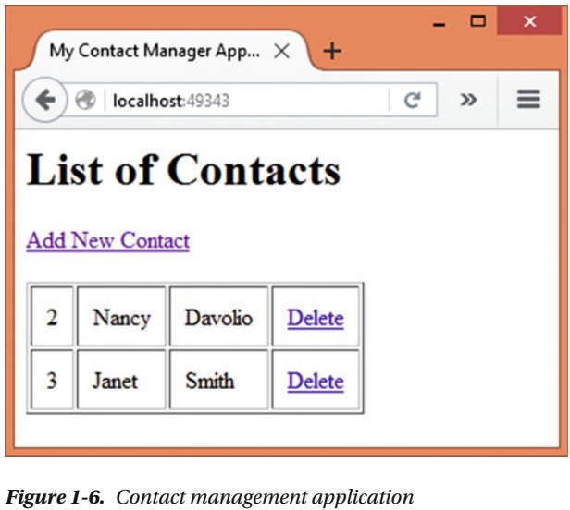
Figure 1-6

Slide 41
NOTE
Microsoft recently announced that ASP.NET 5 is now ASP.NET Core 1.0 and Entity Framework 7 is now Entity Framework Core 1.0.
However, for the sake of consistency, this book will still reference these technologies as ASP.NET 5, MVC 6, and EF 7.
Read the section at the end of this chapter for more details about this change.
You may visit http://www.asp.net and http://docs.asp.net to read more about ASP.NET 5 and MVC 6.

Slide 42
Application Overview
The application presents a list of existing contacts in a table and allows you to delete them using the Delete link.
The Add New Contact link takes you to another page, where new contact details can be entered.
This page is shown in Figure 1-7
The Add New Contact page accepts four pieces of information—First Name, Last Name, Email, and Phone.
All these pieces are mandatory, and basic validation is also wired into the page.
Clicking on the Submit button saves the contact in an SQL Server database.
The following sections will guide you in building this example.

Slide 43
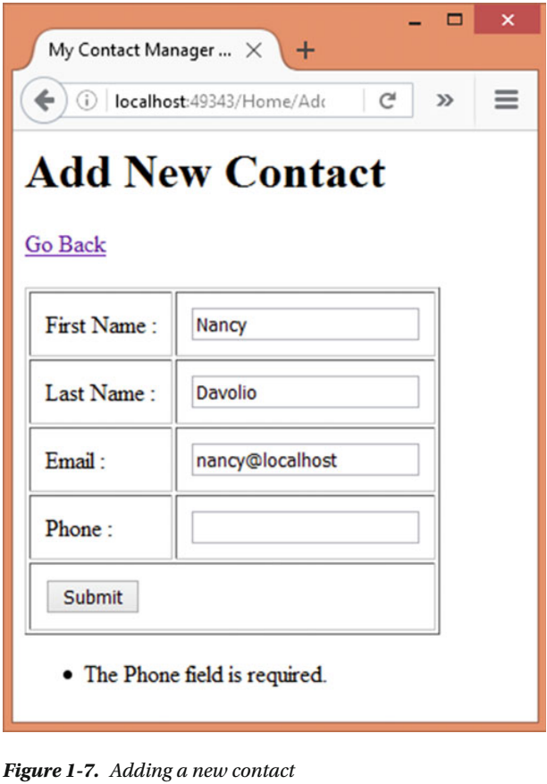
Figure 1-7

Slide 44
Creating a Web Application - Visual Studio
In this section you will create a new ASP.NET web application that uses MVC 6.
Begin by opening Visual Studio and clicking on File ➤ New ➤ Project.
Doing so will open the New Project dialog.
On the left-hand side, expand the Visual C# node and select Web.
Then select ASP.NET Web Application in the main area.
Specify a folder where the project files are to be stored in the Location textbox.
Name the project ContactManager , uncheck the “Create directory for solution” checkbox, and click OK.
This will open the project template selection dialog.
Figure 1-10 shows Solution Explorer after the project’s creation.
(Page 27).

Slide 45
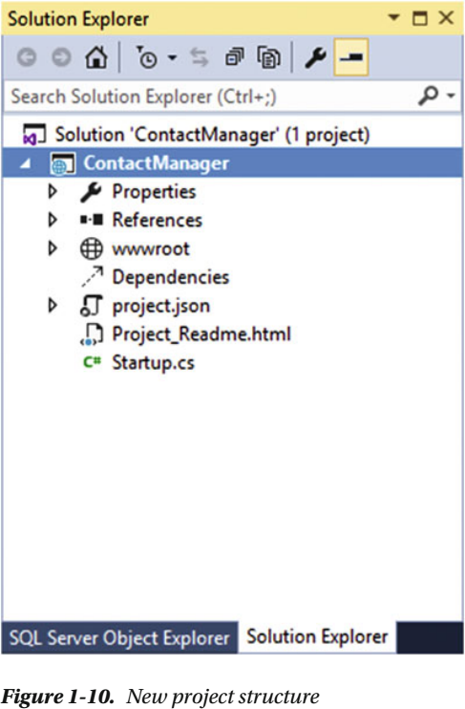
Figure 1-10

Slide 46
Project Structure
As you can see, the newly created project already contains a few items.
Let’s list the ones that are of interest, along with their purpose:
References: Lists references of .NET framework assemblies and NuGet packages used by the project
wwwroot: Contains static files such as HTML files, images, CSS files, and JavaScript files
Project.json: Contains a list of .NET framework assemblies, NuGet packages, and project-level configuration stored in JSON format
Startup.cs: Contains startup configuration of an MVC 6 application. This is where you tell the framework what features and services your application needs.
You might have noticed that there are no Models , Views , and Controllers folders.
Of course, you will add them whenever your project needs them.
Add a new folder under the project root and name it Core.
In all the examples presented in this book, the primary classes related to the example are stored in the Core folder.
This way you can easily store and locate them in one place.
Similarly, add Controllers and Views folders under the project root to store the respective items.

Slide 47
Configuring Project Dependencies
Now that you have created a new project, let’s configure the dependencies of our application. The Project.json file is where you do that. So, open the Project.json file in the Visual Studio editor. Then, modify the dependencies section of the Project.json file as shown in Listing 1-6
(Page 28).

Slide 48
Configuring Application Settings
While Project.config specifies the project-level configuration used by the framework and compilation system, you will need a place to store the application configuration . The ASP.NET MVC 6 stores application configuration in JSON files, which are usually named appsettings.json . You can add a configuration file to your project’s root folder using the Add New Item dialog (see Figure 1-11 ).
(Page 29).

Slide 49
Configuring Application Startup
Open the Startup.cs file. This file contains a class— Startup —whose skeleton is shown in Listing 1-10
(Page 30).

Slide 50
Creating DbContext and Model
In this section you will create an Entity Framework DbContext class needed by your application, as well as the model. Begin by adding a Contact class in the Core folder and write the code shown in Listing 1-16 into it.
(Page 33).

Slide 51
Creating the HomeController
To add HomeController to the Controllers folder, right click on the Controllers folder and select the Add ➤ New Item menu option. The Add New Item dialog is shown in Figure 1-13 .
(Page 34).

Slide 52
Creating the Index and AddContact Views
In this section you will complete the application by creating two views, Index and AddContact . First, add a Home subfolder within the Views folder. Then right click on the Views folder and select the Add ➤ New Item menu options to open the Add New Item dialog. Locate the MVC View Imports Page entry and add a view imports file to the Views folder (Figure 1-14 ).
(Page 36).

Slide 53
Creating the ContactDb Database
The application needs to store its data in an SQL Server database. You can create the database either manually or by using Entity Framework migration commands. In this section, you will use Entity Framework migrations to create the database.
(Page 40).

Slide 54
Going Forward: ASP.NET 5 to ASP.NET Core 1.0
This book uses cutting-edge technology
ASP.NET 5 RC1 and
EF 7 RC1—to build all the examples
Using these not-yet-complete versions gives you a chance to see what’s coming up next.
It is exciting and fun to work with such cutting-edge technology.
However, it has its own price—changes are inevitable!
As I finish this book, Microsoft has made an announcement that ASP.NET 5 will now be called
ASP.NET Core 1.0 and
Entity Framework 7 will be named Entity Framework Core 1.0
Based on this announcement and information available as of this writing, I am summarizing the changes below:
.NET Core 5 will be called .NET Core 1.0
ASP.NET 5 will be called ASP.NET Core 1.0
ASP.NET MVC 6 will be termed ASP.NET Core MVC 1.0
Entity Framework 7 will be named Entity Framework Core 1.0

Slide 55
Going Forward: ASP.NET 5 to ASP.NET Core 1.0 |
Luckily, these changes primarily affect the
nomenclature of packages
assemblies, and
Namespaces
These changes don’t have much impact on
Classes
properties, and
Methods
I expect that a good amount of code discussed throughout this book will remain in a useful form even after these changes come into effect.
However, there will be several areas where these changes will be reflected, and thus you will be required to modify the source code.

Slide 56
Prominent Updates
Although it’s too early to give a precise list of all the changes, here are some prominent areas that will need your attention:
NuGet packages, assemblies, and namespaces with current names of the form Microsoft.AspNet.* will change to Microsoft.AspNetCore.*
You will need to adjust Project.json and the code accordingly.
NuGet packages, assemblies, and namespaces with current names of the form EntityFramework.* will change to Microsoft.EntityFrameworkCore.*
You will need to adjust Project.json and the code accordingly
The version numbers of all the above NuGet packages and assemblies will be reset to 1.0
Target framework monikers and versions (dnx451, dnxcore50) will change
Tooling and exact commands (dnvm, dnu, and dnx) will change
I will be updating the source code of the examples discussed throughout this book onto the RC2 of the framework as needed.
The updated source code will be made available for download on the Apress website.
Of course, you can certainly update the source code yourself if you so wish.

Slide 57
Prominent Updates |
In fact, it would be a good opportunity for you to be a frontrunner in knowing these cutting-edge technologies.

Slide 58
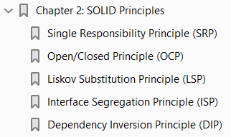
2
SOLID Principles

Slide 59
Intro
In the previous chapter, you were introduced to the SOLID principles of object-oriented design. This chapter will cover all of them in more detail.
Moreover, each principle will be discussed along with a proof of concept example so as to reinforce your understanding.
In order to grasp how these principles can help improve class design, the chapter will discuss wrong design first.
Then, once you are clear about the problems created by the wrong design, this chapter will present the correct design, which rectifies the shortcomings of the improper design.
The explanations will use UML class diagrams to convey the point.
Although I won’t go into the details of UML, for the sake of clarity I will include the necessary detailing of UML diagrams in the form of notes.
To be specific, we will cover the following principles:
Single Responsibility Principle (SRP)
Open/Closed Principle (OCP)
Liskov Substitution Principle (LSP)

Slide 60
Agenda
To be specific, we will cover the following principles:
Single Responsibility Principle (SRP)
Open/Closed Principle (OCP)
Liskov Substitution Principle (LSP)
Interface Segregation Principle (ISP)
Dependency Inversion Principle (DIP)
These principles can be applied to classes belonging to any layer of the application
data access
business logic
user interface
The point is to arrive at a better class design that contributes to the flexible and maintainable code base.

Slide 61
NOTE
As mentioned in Chapter 1, the principles of object-oriented software design discussed in this chapter are elaborated by Robert C. Martin and Micah Martin in their book Agile Principles, Patterns, and Practices in C# .
The acronym SOLID was introduced by Michael Feathers to help one remember these principles easily.

Slide 62
Single Responsibility Principle (SRP)
Single Responsibility Principle can be stated as follows:
A class should have only a single responsibility.
Any class is intended to do some work. That work can be as simple as holding an application state or as complex as resource-intensive processing.
However, if a class is designed to carry multiple responsibilities, it can create problems at a later stage.
Suppose that you are building a web application that deals with customers and orders.
As a part of the functionality, you are required to provide search functionality that searches a customer database on certain criteria.
Now, let’s say you created the CustomerSearch class as shown in Figure 2-1.
As you can see, the CustomerSearch class has three public methods: SearchByCountry( ) , SearchByCompanyName( ) , and SearchByContactName( ).
These three methods search the customer table on the basis of supplied country, company name, and contact person, respectively, and return the search results as a list of Customer objects.
So far, so good.

Slide 63
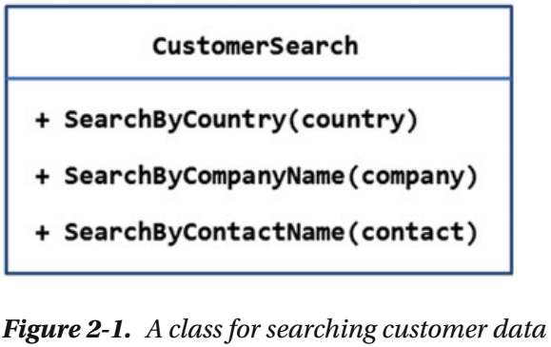
Figure 2-1

Slide 64
NOTE
In UML class diagrams, a class is represented by a rectangle with the class name mentioned in the top compartment. Methods are listed inside the rectangle.
The + sign indicates that a method is public.

Slide 65
New Requirement
Now, say that one day the need arises to export the search results into the Comma Separated Values (CSV) format so that the end user can download the results and open them in Excel or Notepad for further processing.
To deal with this requirement, let’s assume that you modified the CustomerSearch class as shown in Figure 2-2.
The CustomerSearch class now has an additional method— ExportToCSV( ) —that takes the search results as its parameter and then generates the CSV equivalent for the purposes of downloading.
Although this design change sounds quite normal, it has a design flaw.
The CustomerSearch class now has two responsibilities.
Earlier, the CustomerSearch class was responsible only for searching the customer data; now it is also responsible for exporting the data.
Imagine a situation where the need arose to export the data to XML format or PDF format.
If that happened, you would need to change the CustomerSearch class again.
Although there was no change in the search functionality of the CustomerSearch class (which was the original and primary responsibility of the class), you would need to change it, because the data-export functionality was changed.

Slide 66
New Requirement |
Any change in the CustomerSearch class would also require testing to ensure that the changes did not affect the rest of the application.
The root issue here is that the CustomerSearch class is being assigned multiple responsibilities.
There are two possible reasons for changing CustomerSearch —change in search functionality and change in the data-export functionality.
A change in either of those responsibilities requires a change in the CustomerSearch class.
This design issue can be corrected if the CustomerSearch class is designed adhering to Single Responsibility Principle. Let’s see how.

Slide 67
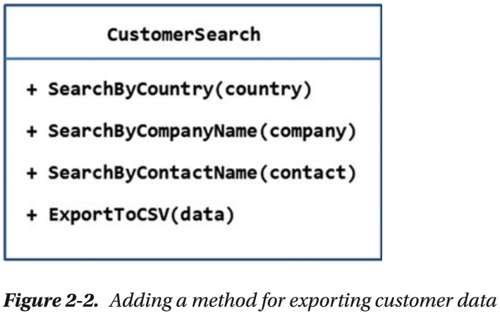
Figure 2-2

Slide 68
Modified Design
Have a look at Figure 2-3, which shows the modified class design .
The modified design has two independent classes— CustomerSearch and CustomerDataExporter.
The former class is given the responsibility of searching customer data.
The responsibility of exporting search results is handled by the latter class using two methods— ExportToCSV( ) and ExportToXML( ) .
This way, CustomerSearch and CustomerDataExporter each have one and only one responsibility.
If in the future you need to export the data into some other format (say, PDF), you would need to modify the CustomerDataExporter class only.
The CustomerSearch class remains unaffected by this change.
This also means that only CustomerDataExporter requires retesting (since only it got changed).
Now the CustomerSearch class has one and only one reason to change—change in the searching logic.

Slide 69
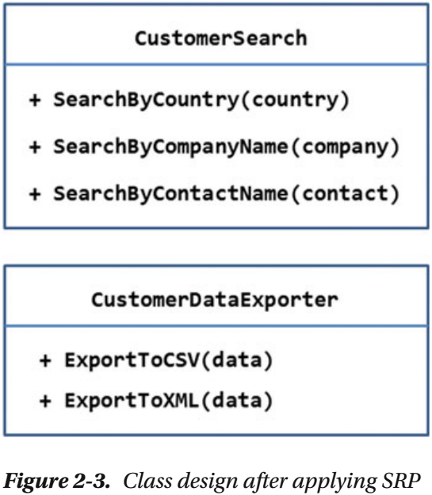
Figure 2-3

Slide 70
Implementation
Just to make your understanding of SRP clear, let’s translate the preceding example into an ASP.NET application.
You will use the Customers table of the Northwind database as a source of customer data.
The main view of the application is shown in Figure 2-4.
As you can see, the main view consists of a textbox to specify search criteria, a dropdown list to select the column to search, and a Search button.
Upon entering a search criteria and clicking the Search button, results are displayed in another view, as shown in Figure 2-5.
The view showing search results renders them in a table.
You can download the results in CSV format by clicking the Export button.
The “Back to search” link takes you to the main view.

Slide 71
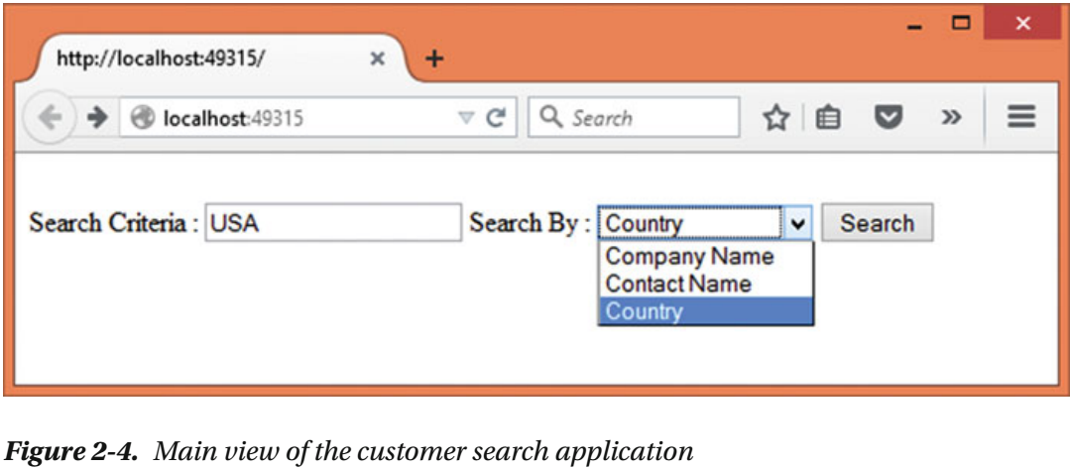
Figure 2-4

Slide 72
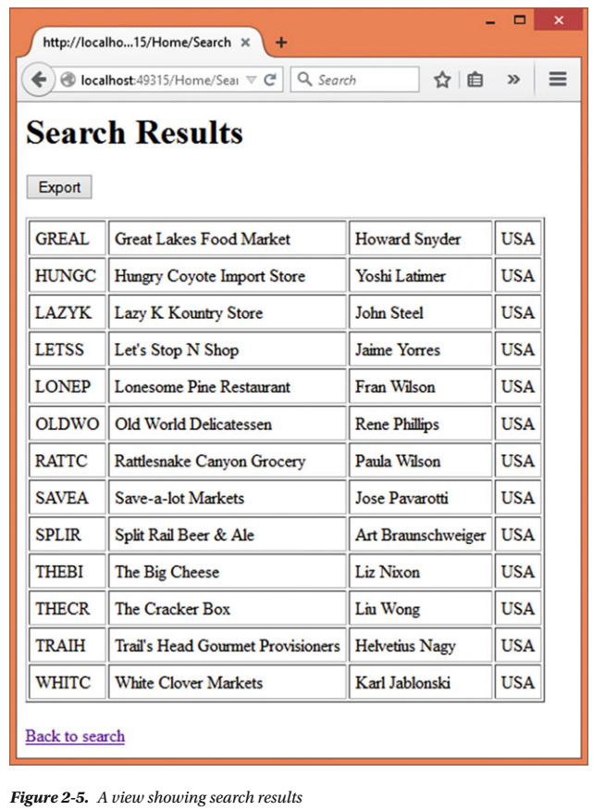
Figure 2-5

Slide 73
Open/Closed Principle (OCP)

Slide 74
Liskov Substitution Principle (LSP)

Slide 75
Interface Segregation Principle (ISP)

Slide 76
Dependency Inversion Principle (DIP)

Slide 77
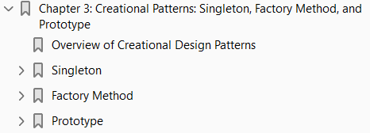
3
Creational Patterns: Singleton, Factory Method, and Prototype

Slide 78
Intro
Gang of Four (GoF) patterns are classified into three categories:
Creational
Structural
Behavioral
In this chapter, you will begin by dissecting a few creational patterns.
As the name suggests, creational patterns are design patterns that deal with
creation of objects, or
object instantiation
The C# language uses the new keyword to instantiate an object of a class.
Typically, you use the new keyword wherever that object is being utilized.
However, this means you must specify a concrete type name at that location.
In certain real-world scenarios, as you will learn in this and the next chapter, it becomes necessary to isolate the object instantiation logic and code from the class that utilizes the object.
That’s where creational patterns come into the picture.
In all there are five creational patterns outlined in the GoF catalog.

Slide 79
Intro |
This chapter will cover three of them, namely
Singleton
factory method, and
Prototype
The remaining two,
abstract factory and
builder, will be covered in the next chapter.

Slide 80
Agenda
Specifically, this chapter will cover the following:
When to use creational patterns
Purpose and role of
Singleton
factory method, and
prototype patterns
UML structure and layout of these three patterns
A proof of concept example that illustrates the implementation-level details about these patterns

Slide 81
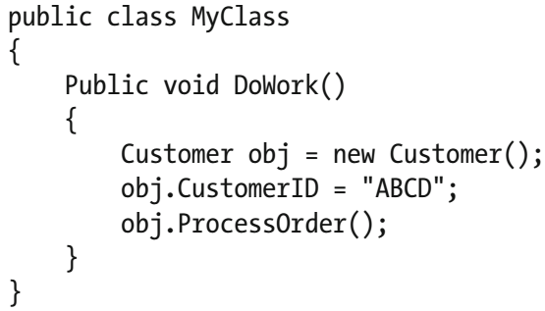
Overview of Creational Design Patterns
Creating objects of a class is a very common requirement in ASP.NET applications.
If you are developing a web application that does something useful, chances are you are utilizing objects of the framework defined as well as custom classes.
In C# you create an object like this:
Here, you are creating an instance of a Customer class using the new keyword.
Most of the time, you write statements like the preceding line inside a method. For example, the following code shows how a method can utilize the new keyword:

Slide 82
Overview of Creational Design Patterns |
The code shown consists of a class, MyClass , that defines the DoWork( ) method.
The DoWork( ) method is assumed to need a Customer object for some work, and hence it instantiates Customer using the new keyword.
Although this kind of code is very common, there are cases where object instantiation is better removed from the main class ( MyClass , in this example).

Slide 83
New Requirement
Suppose that you are building an ASP.NET application that requires displaying graphical charts to the user.
You created a class that does the job of displaying the charts.
You also used this class in your ASP.NET application by instantiating it as discussed earlier.
Over a period of time your web application gets split into two versions —
Free
Paid
For the paid version, you decide to provide much richer charts than in the free version.
Can you sense the problem?
Now you are required to change the code of the ASP.NET application at the point where you instantiate the charting class.
This is necessary, because your main code is responsible for creating instances of the charting class.
Wouldn’t it be great if you could off-load the responsibility of object instantiation to some other class, and simply ask that new class to get you an instance of the desired charting class?
In situations like this, creational patterns come to the rescue.

Slide 84
Creational Patterns
Creational patterns isolate the logic of object instantiation from the main class.
The GoF catalog outlines five creational patterns, namely singleton, factory method, prototype, abstract factory, and builder.
Although this chapter discusses only the first three, it would be worthwhile to take a quick glance at the purpose of each of these patterns.
Singleton: Ensures that only one instance of a class is created
Factory Method: Creates instance of one of the several classes
Prototype: Creates an instance of a class that is a copy or clone of an existing instance
Abstract Factory: Creates instances of families of related classes
Builder: Separates object construction from its representation
Now that you have some background about creational patterns, let’s begin our discussion by dissecting the singleton pattern.

Slide 85
Singleton
Usually, whenever you need an instance of a class, you would use the new keyword and create an instance.
That means every new statement would create a fresh instance of a class.
You could call new five times, and five object instances would be created.
What if you wanted just one, and only one, instance of a class?
That’s where singleton patterns come into picture.
The purpose of the singleton pattern is to ensure that only one instance of a class is created.
The class implementing the singleton pattern not only ensures that only a single instance has been created, but also provides a way to access that instance.
The single object instance under consideration is created only when it is requested for the first time.
A singleton pattern is useful when you are dealing with resource-intensive objects, or when the same object instance is to be passed and used in multiple places.

Slide 86
Design and Explanation
The overall design of the singleton pattern is shown in Figure 3-1 .
It Shows a class, Singleton , that implements the singleton pattern.
The class declares a static variable instance whose visibility is private.
This way the instance can’t be accessed directly by the external world.
Notice that the constructor of the class is private. This means you can’t instantiate the Singleton class using the new keyword.
However, you can still instantiate it from within the class. GetInstance( ) is a public and static method that returns the instance to the caller.
So, GetInstance( ) is an access point to the instance. It is the job of GetInstance( ) to instantiate Singleton if an instance doesn’t already exist, otherwise it returns an existing instance.
In the figure it is assumed that the Singleton class won’t be inherited by any other classes.
What if, for some reason, you wished to inherit from Singleton ?
If so, you would need to make its constructor protected rather than private.

Slide 87
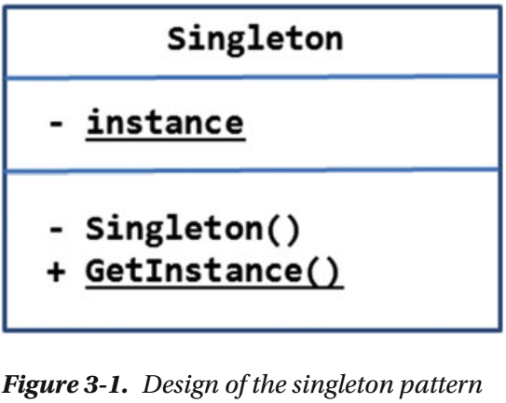
Figure 3-1

Slide 88
NOTE
The UML way to show static members is to underline them.
Thus, the instance variable and the GetInstance( ) method are shown underlined in Figure 3-1 .

Slide 89
Example
Now that you know what the singleton pattern is, let’s try to implement it in an ASP.NET application.
For the sake of this example, let’s assume the following scenario: You are building a blogging engine.
Apart from the blog posts and their details, there is some data and settings that are applicable to the entire application. Such data can be called the metadata of the web application.
For example, details such as contact e-mail, error-logging status, theme, and title of the blog are applicable application wide.
Although these details are application wide, they might be needed in multiple places, such as layout pages, views, and components.
Instead of creating an object instance in each of these locations, you can create it just once and then use the same instance everywhere.
Obviously, the singleton pattern can be used here. In this example you will create an ASP.NET application that simply displays application metadata , as shown in Figure 3-2.
As you can see, the application displays website metadata such as title, administrator e-mail, default theme, and error-logging setting in a table. Of course, you won’t do anything with this metadata as such.
In a more realistic case you would use this metadata while developing various features of the application, such as a contact form or theme.

Slide 90
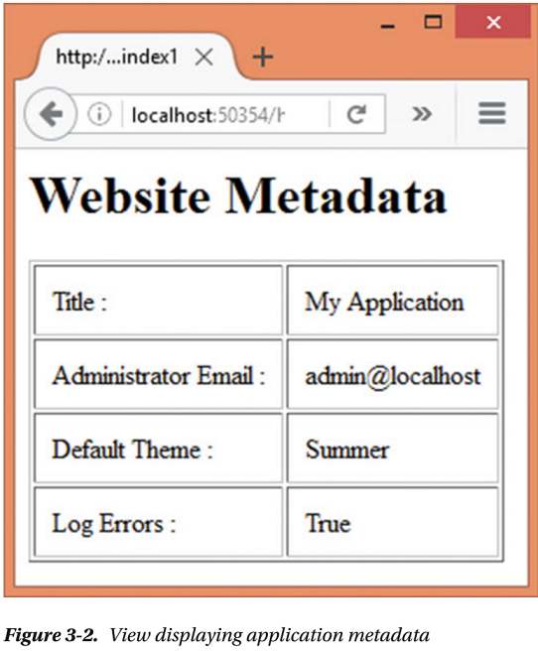
Figure 3-2

Slide 91
Application Development

Slide 92
Factory Method
At times you will have a set of classes performing a similar operation, but the exact class to be used to get the job done is dependent on
Some logic or
Condition
In such cases, a client doesn’t know exactly which class from the available set has been instantiated.
The client relies on some other classes to supply it the required object.
These other classes in turn implement what is known as a factory method, which does the job of creating the required object instance.
As the name suggests, the factory method pattern defines a way to create an object.
And the subclasses decide which class to instantiate.
How do these subclasses decide which class to instantiate?
This is quite application specific, and may involve some
programmatic logic or
configuration setting

Slide 93
Design and Explanation
The UML diagram that shows the overall design of the factory method pattern is shown in Figure 3-4 .
Figure 3-4 shows an abstract class, AbstractCreator , that defines the CreateInstance( ) method.
This is the template of the factory method.
AbstractCreator is inherited by two subclasses —
Creator1 and
Creator2
These subclasses implement the CreateInstance( ) method.
The implementation of CreateInstance( ) needs to decide whether to instantiate
Product1 or
Product2
The Product1 and Product2 classes are the subclasses of the AbstractProduct class.
The decision to instantiate Product1 or Product2 may depend on
some application logic
the current application state
some condition, or

Slide 94
Design and Explanation |
merely a configuration setting
The client (not shown in the figure) can consume
Creator1 or
Creator2
Invoking CreateInstance( ) on either will instantiate either
Product1 or
Product2 (depending on the instantiation logic)
and that instance is supplied to the client

Slide 95
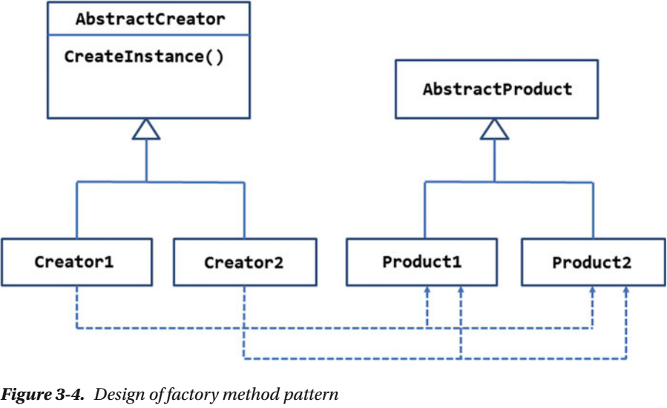
Figure 3-4

Slide 96
Example
Suppose you are building a web application that deals with
workers and
time spent by them on a task
As a part of the system requirements, you are required to show number of hours worked on each day of the week in a graphical form.
Your application can show two types of graphical charts —
bar chart or
pie chart
The decision to show bar chart or pie chart is dependent on the user preference.
Considering these requirements, you came up with a design, as shown in Figure 3-5.

Slide 97
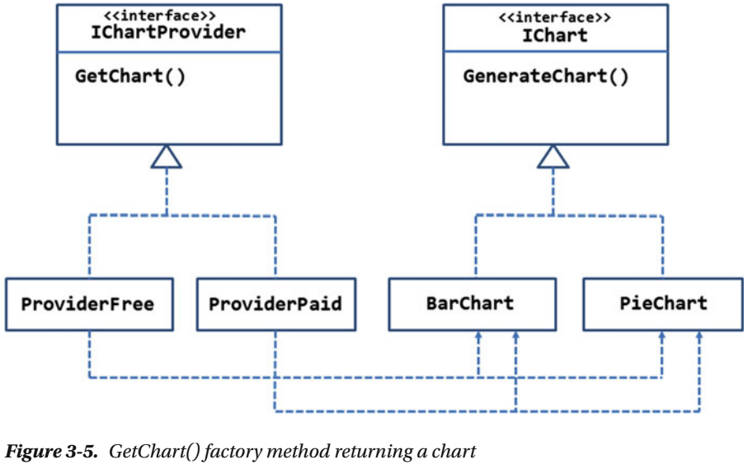
Figure 3-5

Slide 98
Explanation
The figure shows an IChart interface that defines the GenerateChart( ) method.
The GenerateChart( ) method is supposed to generate a chart based on
X and
Y coordinate values
The IChart interface is implemented by two classes —
BarChart and
PieChart
The IChartProvider interface defines the factory method, GetChart( ).
The GetChart( ) method is supposed to return either
BarChart or
PieChart based on user’s preference
The IChartProvider interface is implemented by two classes,
ProviderFree and
ProviderPaid
These classes implement the GetChart( ) factory method.

Slide 99
Explanation |
It is not always necessary that you have multiple classes implementing GetChart( ).
There can be just one “creator” that implements GetChart( ) and returns BarChart or PieChart.
However, at times you may need multiple “creators.”
Suppose that you have two types of user accounts —
free and
Paid
If a user holds a free account, you want to use ProviderFree to generate the charts.
If a user holds a paid account, you want to use ProviderPaid to generate the chart.
You may create ProviderPaid so that it provides
a richer representation of the data or
renders the charts with fancy effects
The client can use ProviderFree or ProviderPaid to get the IChart object.
Once the IChart object is received, the client can assign X and Y coordinate values and generate the chart.
Now that you know the purpose of the factory method pattern, let’s implement the preceding example in an ASP.NET application. Your application will look like Figure 3-6 .

Slide 100
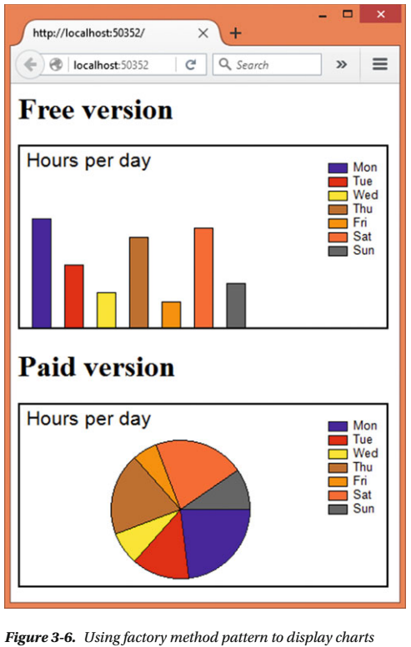
Figure 3-6

Slide 101
Application Overview
As you can see, the application displays two charts —
a bar chart in the top part and
a pie chart in the bottom part of the page
The bar chart is rendered using a BarChart object returned by ChartProviderFree class, and the pie chart is rendered using a PieChart object returned by ChartProviderPaid class.
Begin by creating a new ASP.NET web application using Visual Studio and configure it to use MVC (see Chapter 1 for more details).
Add a reference to the System.Drawing assembly.
You will use classes from this assembly to generate the charts.
Also delete the dnxcore50 entry from the frameworks section of the Project.json file.
Then add the IChart interface to the Core folder and modify it as shown in Listing 3-5.
Now, add the BarChart class to the Core folder and write the code shown in Listing 3-6 in it.
Next, add another class, PieChart , to the Core folder and write the code shown in Listing 3-7 in it.
Next, add the IChartProvider interface to the Core folder as shown in Listing 3-8
Now, add HomeController to the Controllers folder.

Slide 102
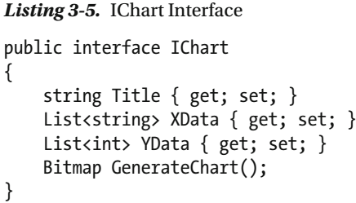
Listing 3-5

Slide 103
IChart Interface
The IChart interface defines
three properties and
one method
The Title property represents the title of the chart under consideration.
The XData and YData properties are List objects that represent X-axis data and Y-axis data, respectively.
The XData property is a list of strings, because the X-axis is going to display days of the week (Monday, Tuesday, etc.).
The YData property is a list of integers, because the Y-axis is going to display number of hours worked.
The GenerateChart( ) method does the job of generating a chart based on
the Title
XData , and YData and
returns the chart as a Bitmap object

Slide 104
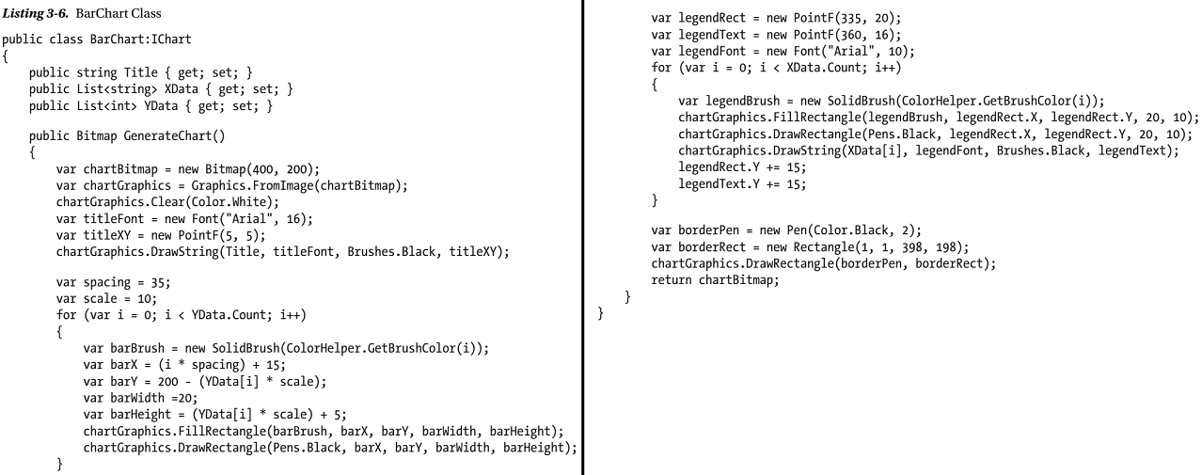
Listing 3-6

Slide 105
BarChart Class
The BarChart class implements the IChart interface.
The three properties —Title , XData , and YData are quite straightforward.
The brain of the BarChart class is the GenerateChart( ) method.
This method uses classes from the System.Drawing namespace to generate a bar chart.
We won’t go into the details of this method here, since the inner workings of this method are not directly connected to the factory method pattern.
It is suffice to say that GenerateChart( ) renders the title, legends, and the bar chart as a Bitmap object.
The Bitmap object is returned to the caller.

Slide 106
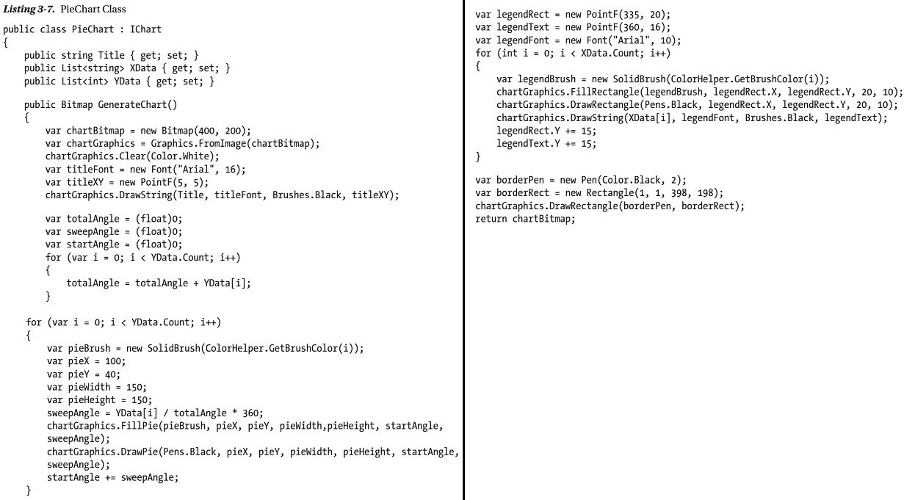
Listing 3-7

Slide 107
PieChart Class
The PieChart class implements the IChart interface.
The PieChart class is quite similar to the BarChart class, except that the GenerateChart( ) method draws a pie chart instead of bar chart.

Slide 108
NOTE
BarChart as well as PieChart classes use a helper class—
ColorHelper
The ColorHelper class simply returns a color based on the supplied number.
To save space, ColorHelper is not shown here.
You can grab it from the code download of this chapter.

Slide 109
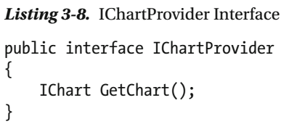
Listing 3-8

Slide 110
IChart Interface
The IChartProvider interface contains a single method —GetChart( )— that returns an IChart object.
The IChartProvider interface is implemented by two classes,
ChartProviderFree and
ChartProviderPaid
These classes are shown in Listing 3-9.
(Page 101).

Slide 111
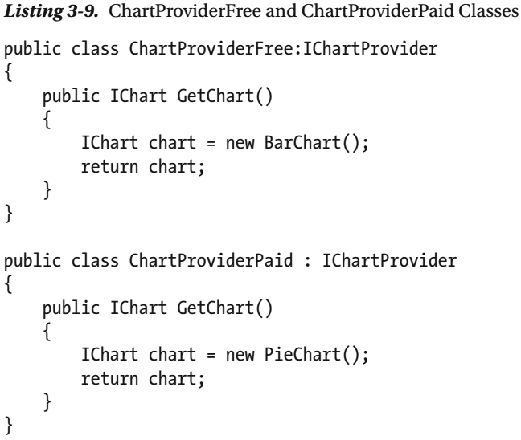
Listing 3-9

Slide 112
ChartProviderFree, ChartProviderPaid Classes
The ChartProviderFree class implements the GetChart( ) method.
The GetChart( ) implementation returns an instance of BarChart to the caller.
The ChartProviderPaid class implements the GetChart( ) method and returns an instance of the PieChart class.
In this example there is
no specific logic or
condition for instantiating
BarChart and
PieChart
However, you can add such a logic to the GetChart( ) method.
Nevertheless, the GetChart( ) method acts as the factory method.

Slide 113
Prototype

Slide 114
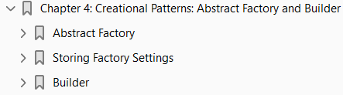
4
Creational Patterns: Abstract Factory and Builder

Slide 115
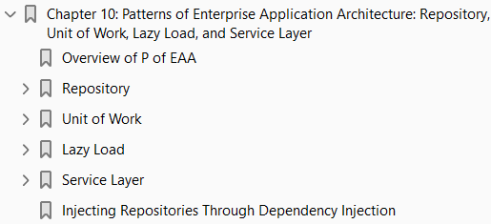
PoEAA: Repository, Unit of Work, Lazy Load, and Service Layer
10

Slide 116
Intro
Thus far in this book you have learned the SOLID principles of object-oriented software design and GoF design patterns.
This chapter will discuss select patterns of enterprise application architecture.
You were introduced to these patterns of enterprise application architecture in Chapter 1.
It’s time to delve into a few of those most commonly used in ASP.NET applications in more detail.
To that end this chapter will discuss the following patterns along with proof of concept examples:
Repository Unit of Work
Lazy Load Service Layer
The catalog of Patterns of Enterprise Application Architecture includes many other patterns.
Due to space constraints this chapter won’t cover them all.
The idea is to make you familiar with some of these patterns so that you can explore more.
The preceding selection of patterns doesn’t imply that other patterns are unimportant or are not used in ASP.NET applications.
The mentioned patterns are selected simply because they are commonly used in real-world ASP.NET applications.

Slide 117
Overview of P of EAA
Before we go into the details of the patterns mentioned earlier, let’s quickly see what an enterprise application is and how these patterns are organized.
In his book, Patterns of Enterprise Application Architecture , Martin Fowler discusses several characteristics of an enterprise application.
It would be worthwhile to take a look at some of them before discussing the P of EAA.
Enterprise Applications are usually large-scale data-driven applications used by a business to get its job done.
They include applications such as a payroll system, web-based order-processing system, or an accounting system.

Slide 118
Characteristics of P o EAA
Such applications often exhibit the following characteristics:
They deal with large amounts of data. This data pertains to the business domain.
It could be customer records, order history, inventory details, or any such application-specific data. Whatever may be the case, the amount of data the application needs to handle is quite large.
Of course, there can’t be a precise measure of “large,” since each system and business is unique in itself.
They store data in some data store. The data handled by these applications is quite important for the functioning of the business.
Obviously, it needs some persistent storage, such as an RDBMS or a NoSQL database.
The database engine is usually separate from the main application.
This way the same data can be consumed by many applications if required.
The data is used in multiuser environment. These applications are usually multiuser systems.
That means at a given point in time many users might access the same data.
It is possible to overwrite changes made by someone without even knowing anything about it.
So, dealing with concurrency and concurrency violations is often required in such applications.

Slide 119
Characteristics of P o EAA |
These applications rely on certain business rules that are known to the business domain experts.
These applications capture those rules and translate them into code.
The business rules can change at any time.
So, even these applications need to be changed or upgraded to take into account the modified or new business rules.
A business usually performs many operations of varying sizes, and each operation deals with a set of data.
The data pertaining to an operation is displayed and manipulated by many pages.
So, such applications usually have a lot of user-interface pages.
All the operations of a business might not be taken care of by a single application.
Multiple applications cater to the business, and these applications might need to interact with each other.
Thus, application integration might also be required by such systems.

Slide 120
Application Layers
If you review the preceding characteristics, you will find that they basically talk about three distinct areas —
data management business rules user interface
That’s why modern applications divide the whole application into three conceptual layers:
Data-access layer
Business-logic layer
User-interface or presentation layer
An application that is divided into these three layers can be pictorially represented as shown in Figure 10-1 .
As shown in the figure, the entire application is divided into three conceptual layers.
The data-access layer deals with the data store – specific operations, such as Create-Read-Update-Delete (CRUD) and stored procedures.
The business-logic layer encapsulates the business-specific processes and rules.
It also communicates with the data-access layer to read and write business data to the persistent data store.
The presentation layer consists of a user interface (a browser-based user interface in the case of ASP.NET) that displays the data to the end user and also accept input from the end user.

Slide 121
Application Layers |
Since each layer deals with a specific task, modifications, extensions, and maintenance of such systems becomes easier.
As far as an ASP.NET application is concerned, you may create the data-access layer using ADO.NET, Entity Framework, and class libraries.
The business-logic layer usually consists of class libraries or services. And the presentation layer consists of views, Web Forms, or even HTML pages.
It must be noted that this division is said to be conceptual because all three pieces can reside on a single server.
For larger systems these layers might be deployed onto different physical servers, resulting in a distributed system.
In the latter case they are called tiers. The term 3-tier is often used to cover both the architectures.

Slide 122
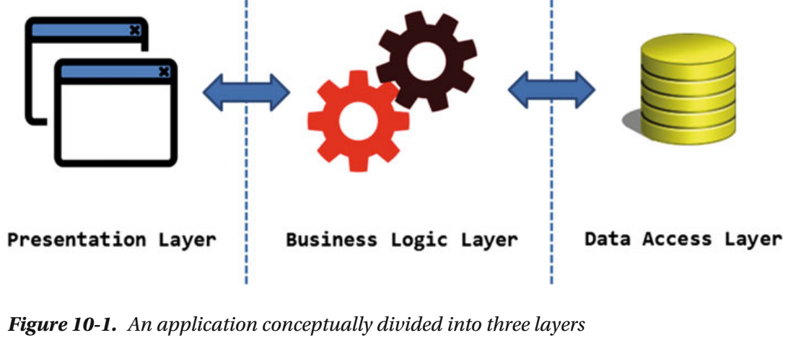
Figure 10-1

Slide 123
P o EAA Grouping
Martin Fowler’s book, Patterns of Enterprise Application Architecture , groups the patterns in such a way that they can be associated with one of these three layers.
The grouping of these patterns is as follows:
Domain logic patterns
Data source architectural patterns
Object-relational behavioral patterns
Object-relational structural patterns
Object-relational metadata mapping patterns
Web presentation patterns
Distribution patterns
Offline concurrency patterns
Session state patterns
Base patterns

Slide 124
P o EAA Grouping |
Each of these groups contains several patterns. Of course, this book doesn’t cover all of them.
The remainder of this chapter will discuss select patterns that are commonly used in ASP.NET applications.
To be specific, the following patterns are discussed (the group each of them belongs to is mentioned in the bracket):
Repository (Object-Relational Metadata Mapping)
Unit of Work (Object-Relational Behavioral)
Lazy Load (Object-Relational Behavioral)
Service Layer (Domain Logic)

Slide 125
Repository

Slide 126
Design and Explanation

Slide 127
Example

Slide 128
Unit of Work

Slide 129
Design and Explanation

Slide 130
Example

Slide 131
Lazy load

Slide 132
Design and Explanation

Slide 133
Example

Slide 134
Service Layer

Slide 135
Design and Explanation

Slide 136
Example

Slide 137
Injecting Repositories Through Dependency Injection

Slide 138
PoEAA Catalog
Pattern Movement

Slide 139
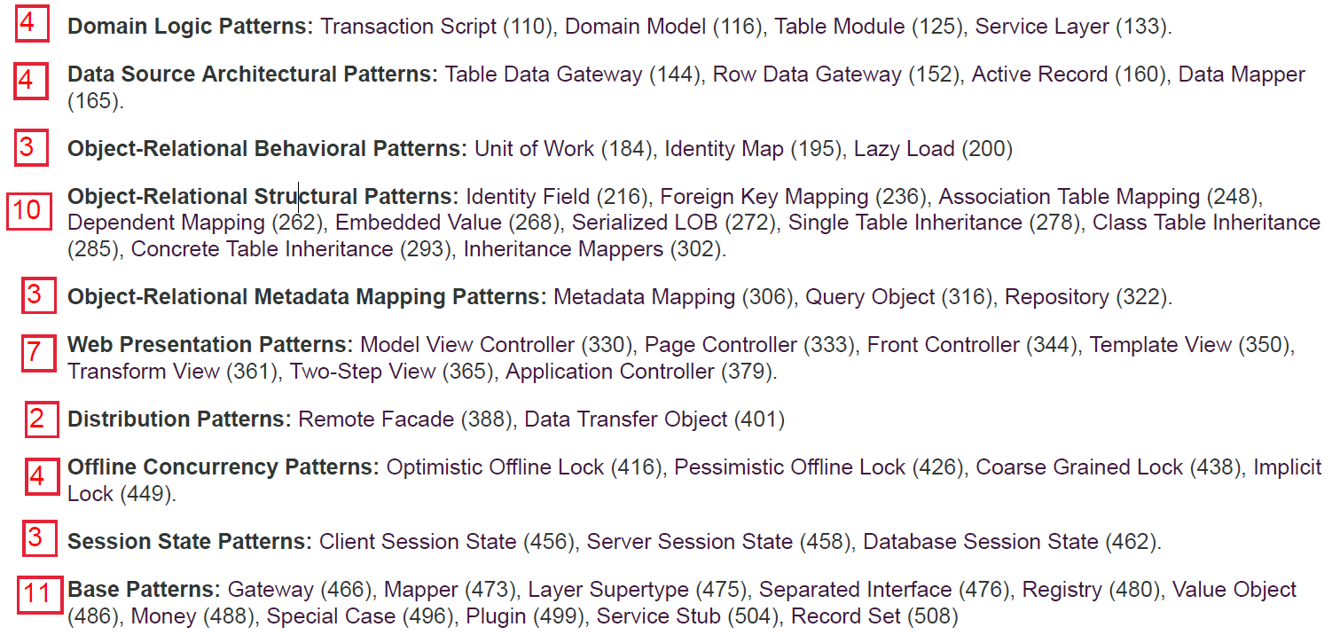
PoEAA Catalog

Slide 140
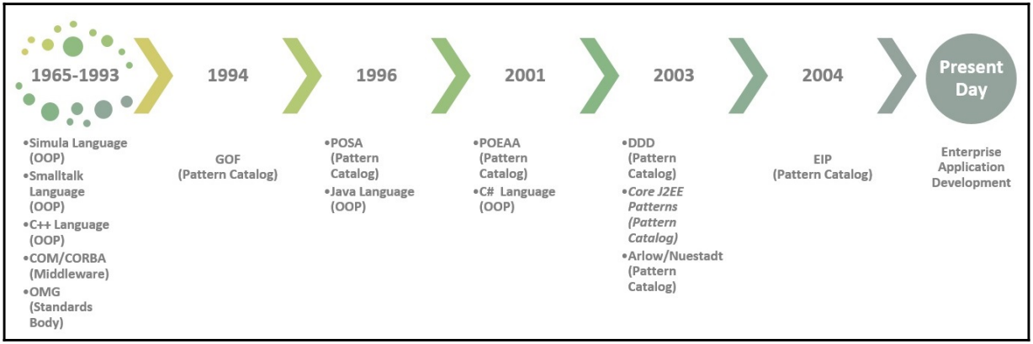
Pattern Movement

